Slide 1


E-mail, Online Shopping, Reservation of tickets, E-commerce websites
MADHAV SHAH

Slide 2
Roadmap
Introduction To Email
Reservation of tickets
Conclusion
1
3
5
2
4
Online Shopping
E-commerce Websites

Slide 3
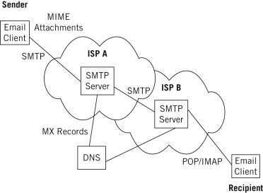
E-MAIL
Messages distributed by electronic means from one computer user to one or more recipients via a network.
There are three common protocols used to deliver email over the Internet: the Simple Mail Transfer Protocol (SMTP), the Post Office Protocol (POP), and the Internet Message Access Protocol (IMAP)..

Slide 4
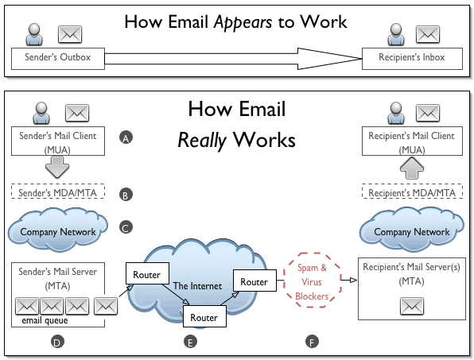
HOW EMAIL REALLY WORKS
Whoa
that's Amazing

Slide 5
Types Of Email
Webmail Email Client
If you’ve ever started a Gmail, Hotmail, Yahoo or other email account, chances are you’ve used webmail. With webmail, you read and send email through your web browser and a web-based interface.
Example: sbmp@gmail.com
An email client is a piece of software that is installed on your computer. You then use this software to download your emails from the server to your computer and from there you can read an send emails.
Example: user@sbmp.com

Slide 6
NUMBER OF MAILS SEND IN A DAY
306 billion
Whoa! That’s a big number.
NUMBER OF EMAIL ACCOUNTS.
7 billion
6

Slide 7
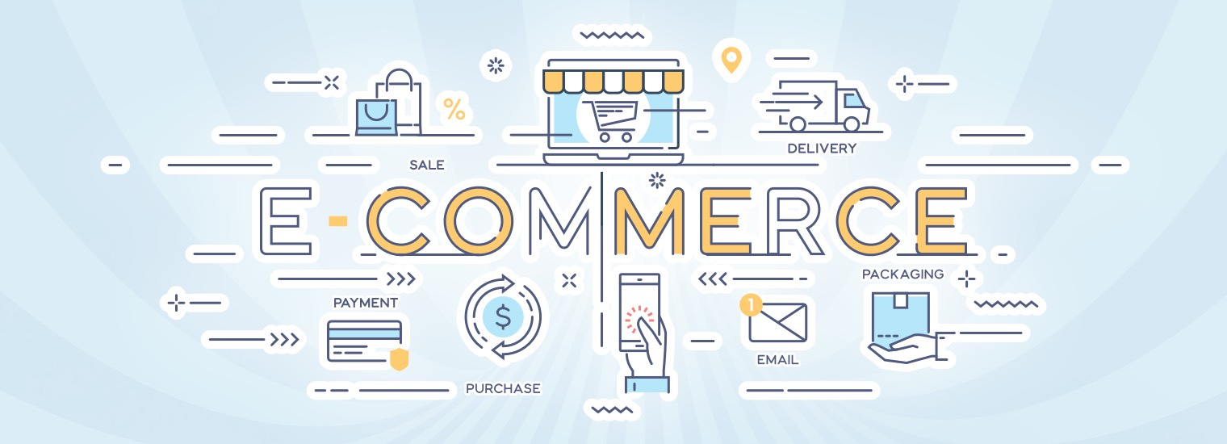
E-commerce websites
E-Commerce websites are online portals that facilitate online transactions of goods and services through means of the transfer of information and funds over the Internet.

Slide 8
THE PROCESS OF E-COMMERCE WEBSITE
A consumer uses Web browser to connect to the home page of a merchant's Web site on the Internet.
The consumer browses the catalog of products featured on the site and selects items to purchase.
When the consumer is ready to complete the purchase of selected items, she provides a bill-to and ship-to address for purchase and delivery.
When the merchant's Web server receives this information, it computes the total cost of the order– including tax, shipping, and handling charges and then displays the total to the customer.
The customer can now provide payment information, such as a credit card number, and then submit the order.
When the credit card number is validated and the order is completed at the Commerce Server site, the merchant's site displays a receipt confirming the customer's purchase.
The Commerce Server site then forwards the order to a Processing Network for payment processing and fulfillment.

Slide 9
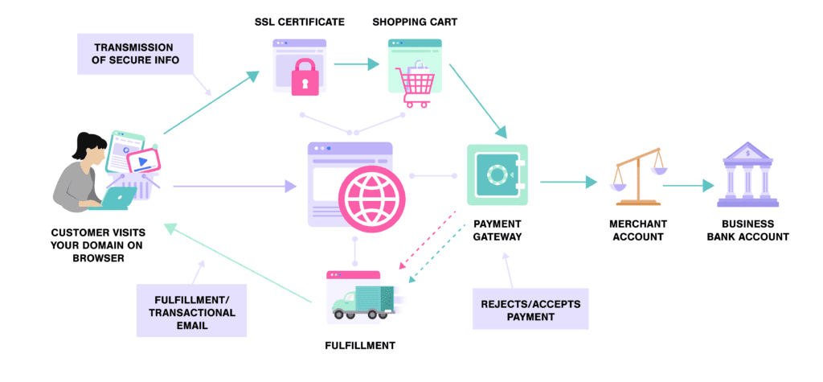
WORKING OF A E-COMMERCE WEBSITE

Slide 10
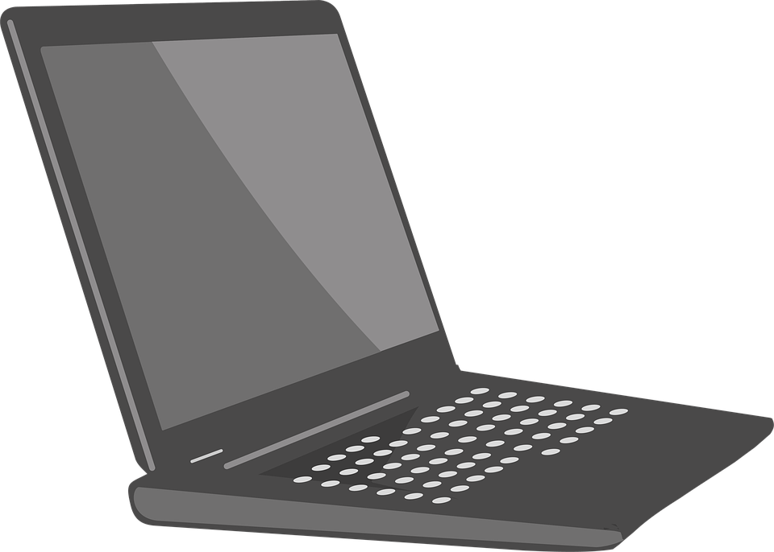
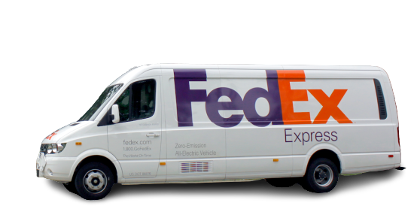
Online Shopping
Online shopping is a form of electronic commerce which allows consumers to directly buy goods or services from a seller over the Internet using a web browser or a mobile app.
WEB
SERVER
ORDER
MANAGEMENT
STOCK DATABASE
MERCHANT
SYSTEM
WAREHOUSE AND DISPATCH
BANK
COMPUTERS

Slide 11







SOME EXAMPLES OF ONLINE SHOPPING ARE AS FOLLOWS :-

Slide 12
Reservation of tickets
An Online Reservation System allows all kinds of service businesses to accept bookings and appointments online. Businesses can manage their phone and in-person bookings with ease using a web-based booking system, such as an online reservation system or phone app for the same software.
It's crucial that every business has a recognizable online presence, no matter what the sector. Modern technology help businesses get found online, and it also helps them easily convert visits into revenue. Businesses should also consider using an online reservation system to help them easily book visitors.

Slide 13
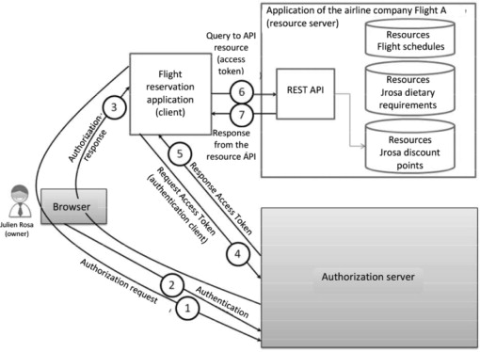
Example of Reservation of tickets

Slide 14
WEBSITES FOR Reservation of tickets
IRCTC
https://www.irctc.co.in
https://www.railyatri.in
https://www.confirmtkt.com
AEROPLANE
https://www.emeraldairlines.com
https://www.qatarairways.com
https://www.goindigo.in

Slide 15
Conclusion
There by we have learned what is email, Protocol used in email and different types of email.
How E-commerce websites work.
Working of of online shopping websites.
How reservation of tickets websites work.

Slide 16
ANY QUESTIONS?

Slide 17
Thank You
MADHAV SHAH

